Slide 1
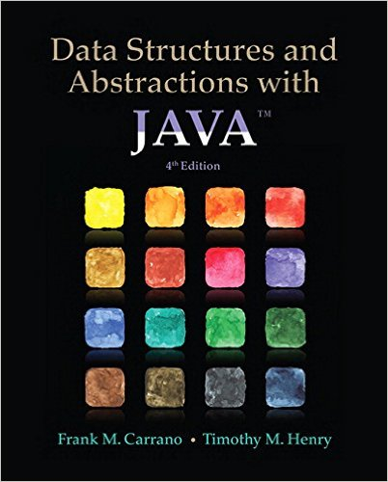
Lecture 12
Chapter 21:Introducing Hashing
Chapter 22: Hashing as a Dictionary Implementation

Slide 2
Contents
What Is Hashing?
Hash Functions
  Computing Hash Codes
  Compressing a Hash Code into an Index for the Hash Table
Resolving Collisions
  Open Addressing with Linear Probing
  Open Addressing with Quadratic Probing
  Open Addressing with Double Hashing
  A Potential Problem with Open Addressing
  Separate Chaining

Slide 3
Objectives
Describe basic idea of hashing
Describe purpose of hash table, hash function, perfect hash function
Explain why to override method hashCode for objects used as search keys
Describe how hash function compresses hash code into index to the hash table

Slide 4
Objectives
Describe algorithms for dictionary operations getValue, add, and remove when open addressing resolves collisions
Describe separate chaining as method to resolve collisions
Describe algorithms for dictionary operations getValue, add, and remove when separate chaining resolves collisions
Describe clustering and problems it causes

Slide 5
What Is Hashing?
Method to locate data quickly
  Ideally has O(1) search times
  Yet cannot do easy traversal of data items
Technique that determines index using only a search key
Hash function locates correct item in hash table
  Maps or “hashes to” entry

Slide 6
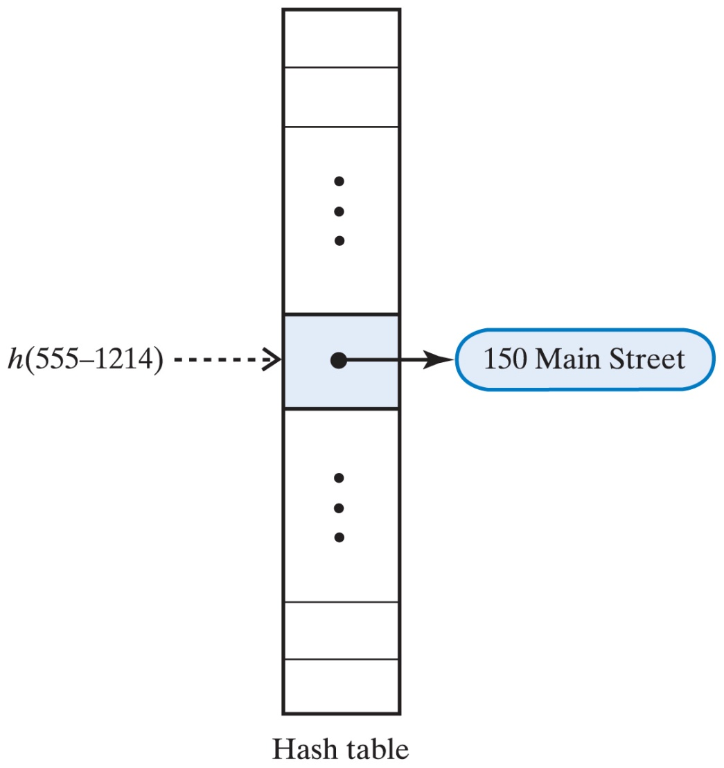
What is Hashing?
The term "hash" comes by way of analogy with its standard meaning in the physical world, to "chop and mix".
A technique that determines an index or location for storage of an item in a data structure
The hash function receives the search key
  Returns the index of an element in an array called the hash table
  The index is known as the hash index
A perfect hash function maps each search key into a different integer suitable as an index to the hash table

Slide 7
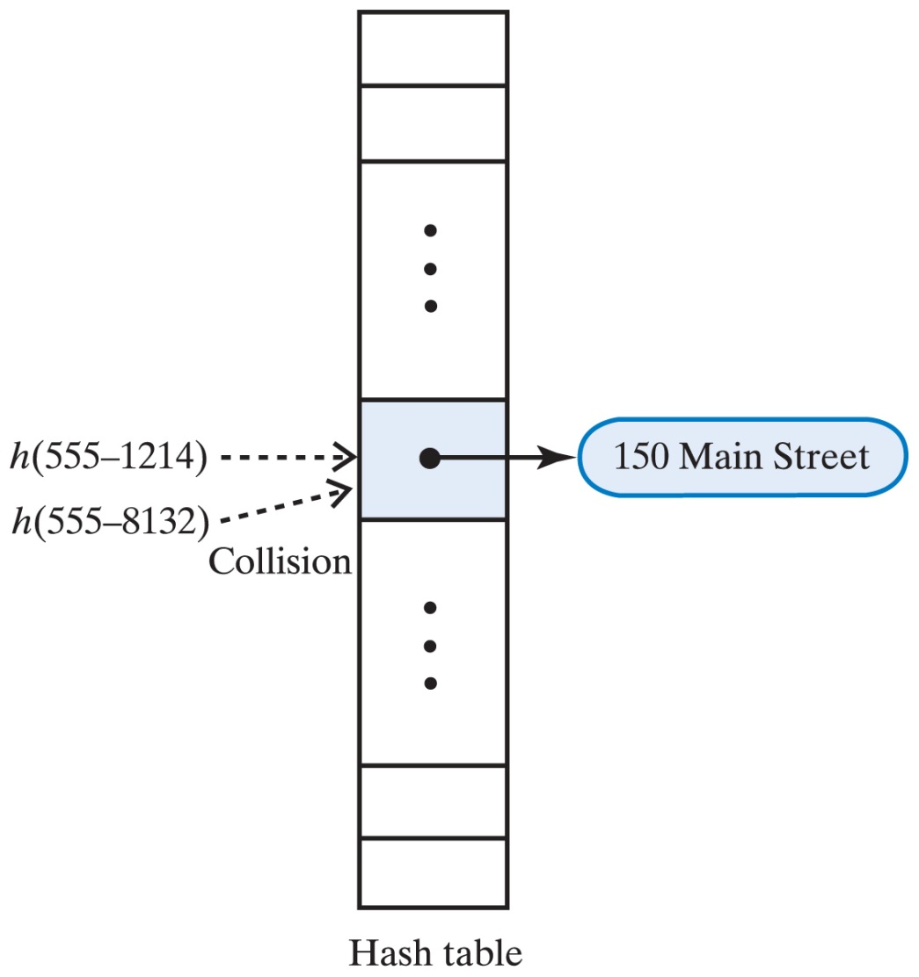
What is Hashing?
Two steps of the hash function:
  Convert the search key into an integer called the hash code
  Compress the hash code into the hash index for the given hash table
Unfortunately, typical efficient hash functions are not perfect
  They can allow more than one search key to map into a single index
  This is known as a collision

Slide 8
Hash Functions
General characteristics of a good hash function:
  Minimize collisions
  Distribute entries uniformly throughout the hash table
  Be fast to compute
Computing hash functions in Java:
  Object class has a method called hashCode()
    all objects inherit that
    it uses the address of the object to compute a hash code
      therefore, it is not good for hashing, because two equal objects have different addresses, so they would produce different indices
  Therefore:
    If a class overrides the method equals, it should override hashCode
    If the method equals considers two objects equal, hashCode must return the same value for both objects
    If an object invokes hashCode more than once during execution of program on the same data, it must return the same hash code

Slide 9
Computing Hash Codes
The hash code for a String s can be computed as follows:
Hash code for a primitive type
  Use the primitive type key itself as int (cast byte, short, or char to int)
  Manipulate internal binary representations
    For example use folding (use exclusive-OR on parts of the key):
int hashCode = (int)(key ^ (key >> 32)); // key is long (64 bits)
long bits = Double.doubleToLongBits(key); // key is double
int hashCode = (int)(bits ^ (bits >> 32));
s[0]*31^{(n-1)} + s[1]*31^{(n-2)} + ... + s[n-1]
using int arithmetic, where: s[i] is the i^{th} character of the string, n is the length of the string.
(The hash value of the empty string is zero.)

Slide 10
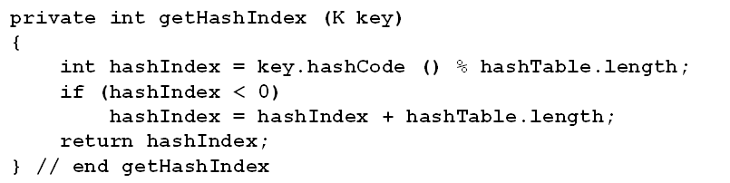
Compressing a Hash Code
We must compress the calculated hash code so it fits into the index range
    remember that we are looking for a location in the table, an index
Typical method for compressing a hash code c is to compute c%n
    where % designates the modulo operator
    n is the size of the hash table
  index will then be between 0 and n – 1
  n should be a prime number
    index values will be distributed throughout the range 0 through n-1

Slide 11
Resolving Collisions
Options when hash functions return location already used in the table
  Use another location in the table
  Change the structure of the hash table so that each array location can represent multiple values
Conflict resolution techniques
  Open addressing (look for another non-occupied slot – “open address”):
    Linear probing
    Quadratic probing
    Double hashing
  Separate chaining
    accommodate more than one value per slot

Slide 12
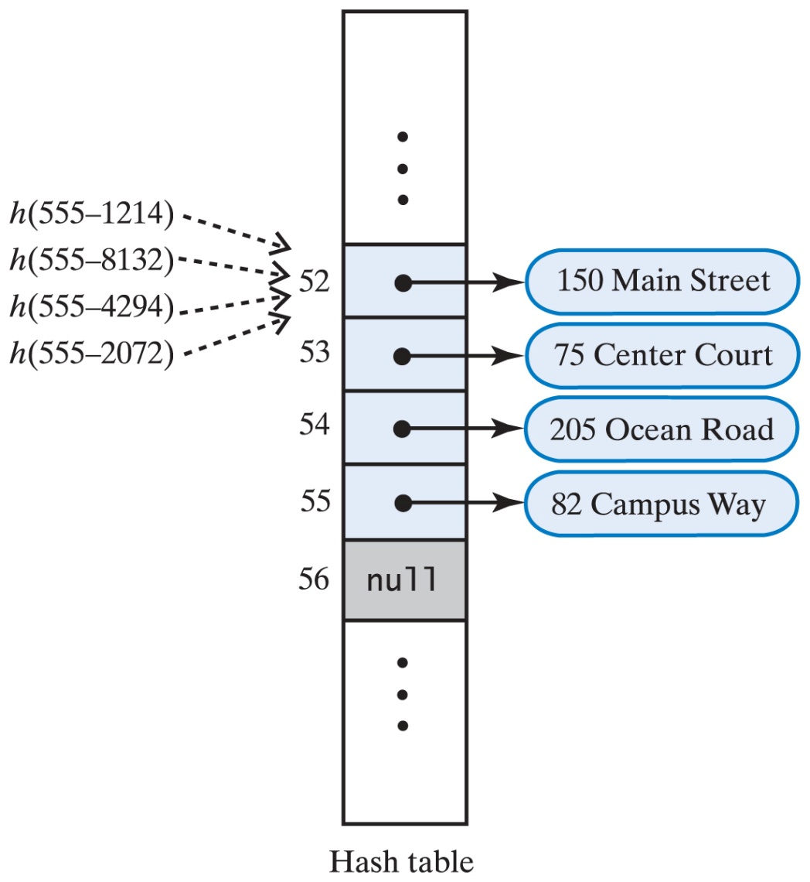
Open Addressing with Linear Probing
Open addressing scheme locates alternate location
  New location must be open, available
Linear probing
  If collision occurs at hashTable[k], look successively at location
  k + 1, k + 2, …
Problem:
  what is what?

Slide 13
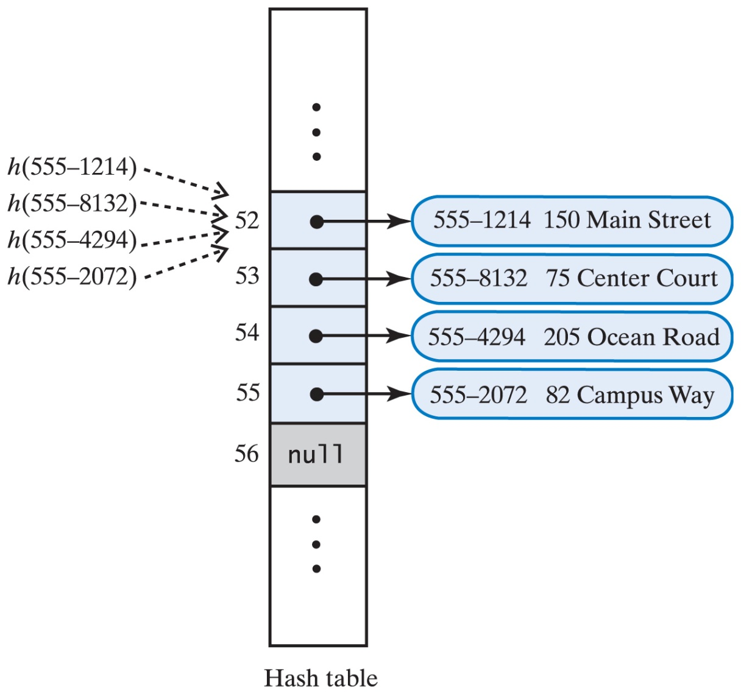
A Revision of Linear Probing
A revision of the hash table shown earlier when linear probing resolves collisions
Each entry contains a search key and its associated value
  We need to perform a sequential search
See demo

Slide 14
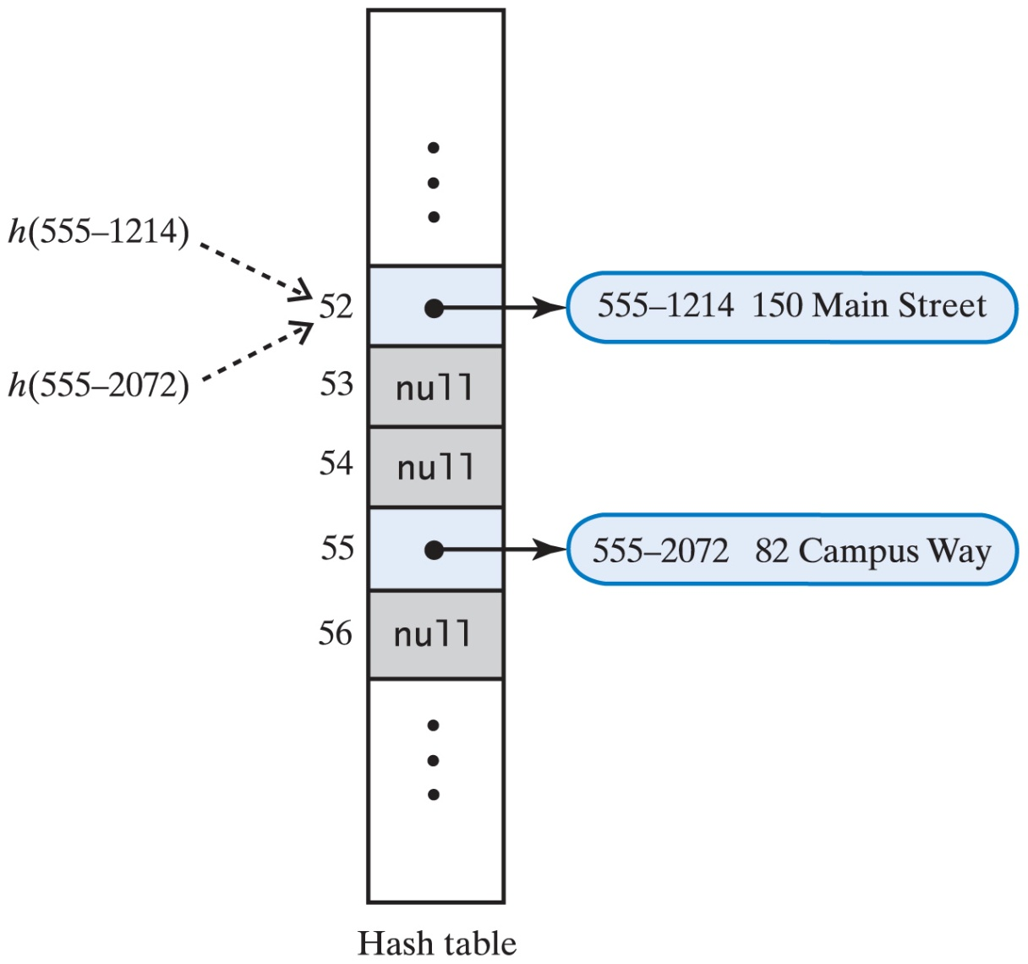
Removals in Linear Probing
A hash table after remove() used null to remove entries.

Slide 15
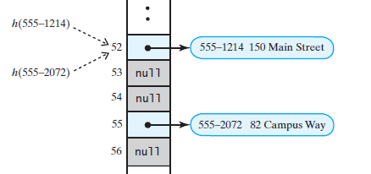
Removals
Problem
  h(555-2072) goes
  to location 52
  Collision occurs
  Linear probing cannot find desired data
Removal must be marked differently
  Instead of null, use a value to show slot is available but location’s entry was removed
Location reused later for an add

Slide 16
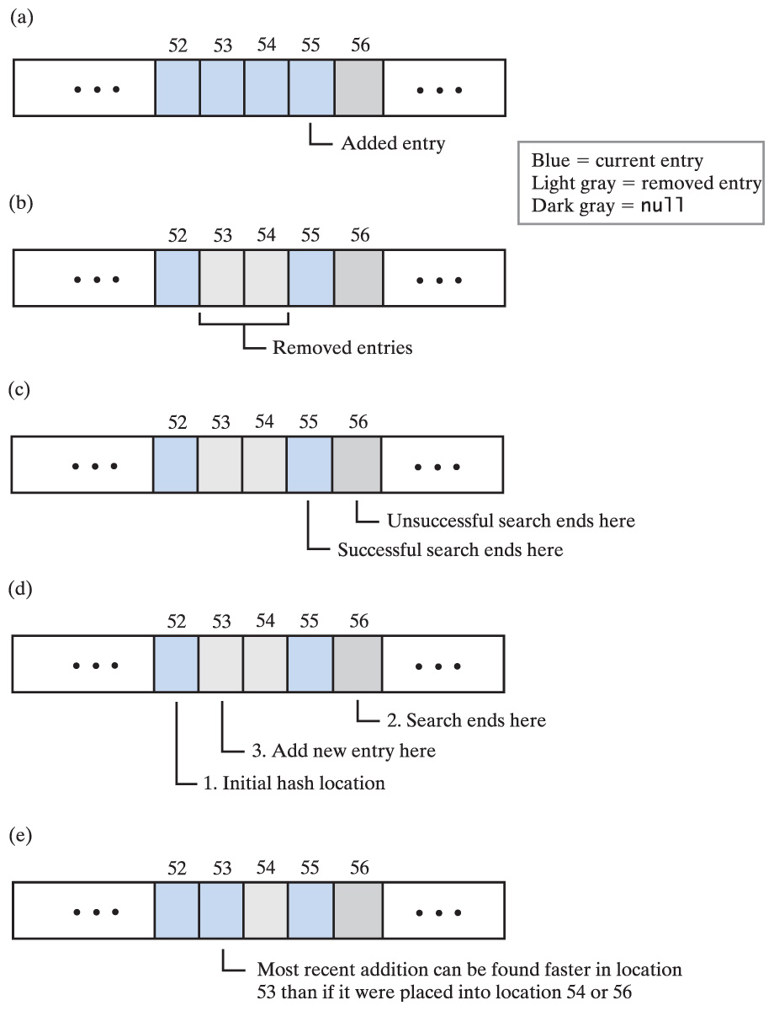
A Strategy to Deal with Removals
Distinguishing among three kinds of locations in the hash table
  Occupied
    The location references an entry in the dictionary
  Empty
    The location contains null and always did
  Available
    The location's entry was removed from the dictionary

Slide 17
Searches that Dictionary Operations Require
  To retrieve an entry
    Search the probe sequence for the key
    Examine entries that are present, ignore locations in available state
    Stop search when key is found or null reached
  To remove an entry
    Search the probe sequence same as for retrieval
    If key is found, mark location as available
  To add an entry
    Search probe sequence same as for retrieval
    Note first available slot
      Use available slot if the key is not found

Slide 18
Clustering
When collisions resolved with linear probing
  Groups of consecutive locations occupied
  Called primary clustering
If clusters grow (size and number) can cause problems
  Longer searches for retrievals

Slide 19
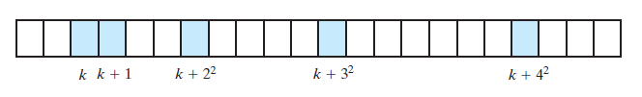
Open Addressing with Quadratic Probing
Avoid primary clustering by changing the probe sequence
Alternative to going to location k + 1
  Go to k + 1, then k + 4, then k + 9
  In general go to k + j² for j = 1, 2, 3, …
Figure 21-7 A probe sequence of length five using quadratic probing

Slide 20

Open Addressing, Quadratic Probing
2 3 6 11 18
Uses the following formula:
(k + j²) modulo n for j >= 0
k – hash index; n - table size; j – probe sequence
Given k_{i} we can compute k_{i+1}
k_{i+1} = (k_{i} + 2i +1) modulo n

Slide 21
Exercise
If a hash table contains 17 locations and the hash index is 3, what are the first 8 indices in the probe sequence that the quadratic probing defines?
  3
  3+1 -> 4
  3+4 -> 7
  3+9 -> 12
  3+16 -> 2
  3+25 -> 11
  3+36 -> 5
  3+49 -> 1
Uses the following formula:
(k + j²) modulo n for j >= 0
k – hash index; n - table size; j – probe sequence
0 1 2 3 4 5 6 7 8 9 10 11 12 13 14 15 16
 | 8 | 5 | 1 | 2 | 7 |  | 3 |  |  |  | 6 | 4

Slide 22
Open Addressing with Double Hashing
Resolves collision by examining locations at original hash index
  however the step increment determined by the secondary hash function
Second hash function:
  is different from first
  depends on search key
  must return a nonzero value
Reaches every location in hash table if table size is prime
Avoids both primary and secondary clustering

Slide 23
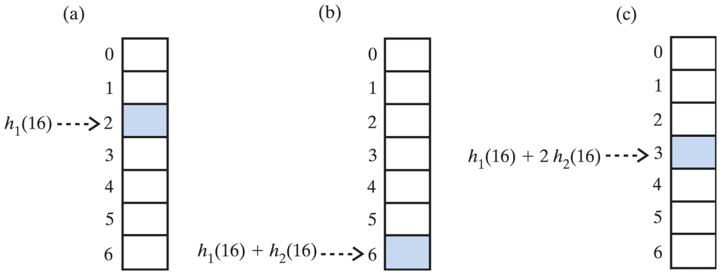
Example
Consider the following pair of hash functions for a hash table of size 7:
  h₁(key) = key modulo 7
  h₂(key) = 5 – (key modulo 5)
  For a search key of 16, we have:
  h₁(16) = 2 ← gives the hash index
  h₂(16) = 4 ← gives the step for hash index increment
Probe sequence: 2 6 3 0 4 1 5 2 …reaches all locations

Slide 24
Question
What happens if we change the size of the table to 6?
  h₁(key) = key modulo 6
  h₂(key) = 5 – (key modulo 5)
  For a search key of 16, we have:
  h₁(16) = 4
  h₂(16) = 4
Probe sequence: 4 2 0 4 2 0 4 2 … does NOT reach all locations before it begins to repeat.
Why?
The table size, 6, is NOT prime.

Slide 25
Question
What probe sequence does double hashing follow when the search key is 16 and the hash functions are:
  h₁(key) = key modulo 13
  h₂(key) = 7 – (key modulo 7)
  For a search key of 16, we have:
  h₁(16) = 3
  h₂(16) = 5
Probe sequence: 3 8 0 5 10 2 7 12 4 9 1 6 11 3 … reaches all locations if the hash table size is 13, before the sequence repeats

Slide 26
Potential Problem with Open Addressing
Frequent additions and removals
  Can cause every location in hash table to reference either current entry or former entry
Could result in unsuccessful search requiring check of every location
Possible solutions
  Increase size of hash table
  Separate chaining

Slide 27
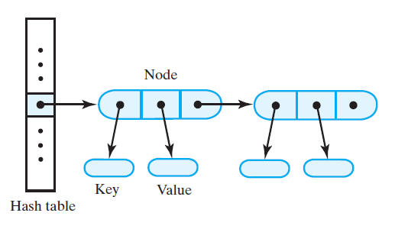
Separate Chaining
Each location of hash table can represent multiple values
  Called a “bucket”
To add, hash to bucket, insert data in first available slot there
To retrieve, hash to bucket, traverse bucket contents
To delete, hash to bucket, remove item

Slide 28
Separate Chaining
Bucket representation
  List (sorted or not)
  Chain of linked nodes
  Array
Arrays require extra overhead
Linked list, chain of linked nodes is reasonable choice

Slide 29
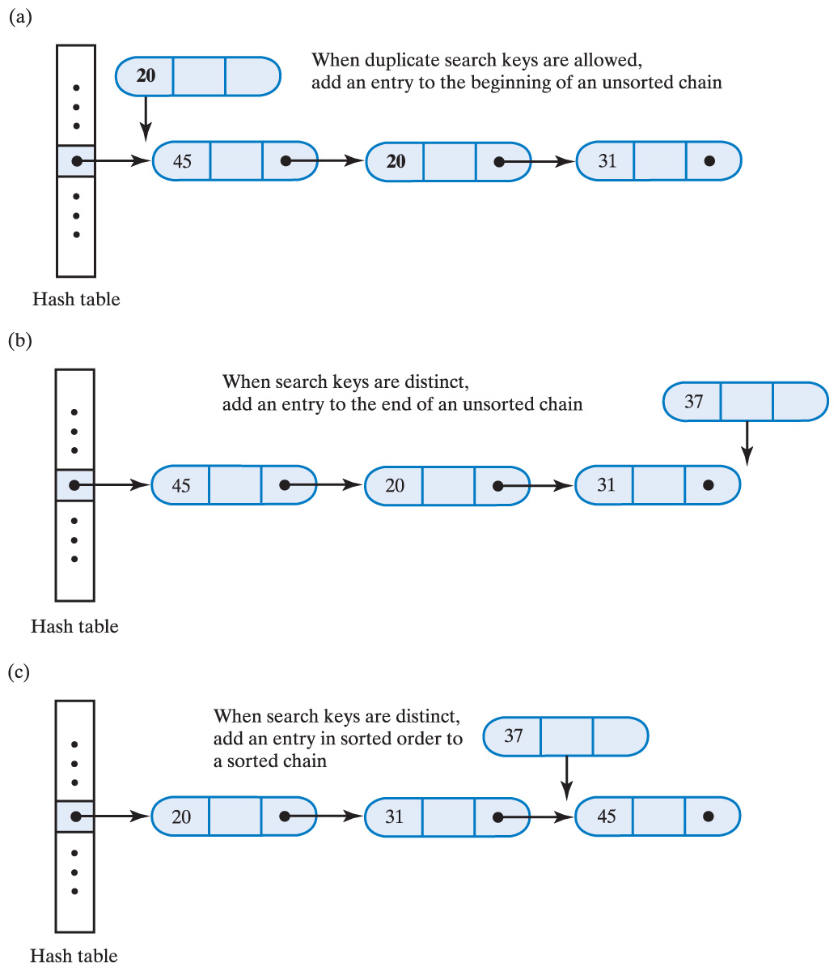
Separate Chaining
Where new entry is inserted into linked bucket when integer search keys are
  (a) duplicate and unsorted
  (b) distinct and unsorted
  (c) distinct and sorted
Demo

Slide 30
Hashing as a Dictionary Implementation

Slide 31
Contents
The Efficiency of Hashing
  The Load Factor
  The Cost of Open Addressing
  The Cost of Separate Chaining
Rehashing
Comparing Schemes for Collision Resolution

Slide 32
Contents
A Dictionary Implementation That Uses Hashing
  Entries in the Hash Table
  Data Fields and Constructors
  The methods getValue, remove, and add
  Iterators
Java Class Library: The Class HashMap
Java Class Library: The Class HashSet

Slide 33
Objectives
Describe relative efficiencies of various collision resolution techniques
Describe hash table’s load factor
Describe rehashing and why necessary
Use hashing to implement ADT dictionary

Slide 34
Efficiency of Hashing
Observations
  Successful retrieval or removal has same efficiency as successful search
  Unsuccessful retrieval or removal has same efficiency as unsuccessful search
  A successful addition has same efficiency as unsuccessful search
  An unsuccessful addition has same efficiency as successful search

Slide 35
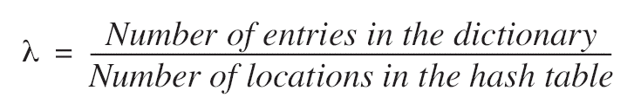
Efficiency Observations
Perfect hash function not always possible or practical
  thus, collisions likely to occur
As hash table fills collisions occur more often
Measure for table fullness, the load factor λ

Slide 36
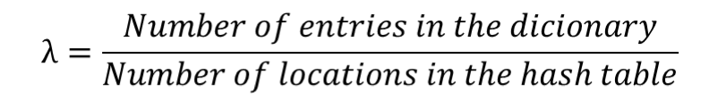
Efficiency of Hashing
Load factor
Minimum load factor = 0
  When dictionary is empty
  It is never negative
Maximum load factor
  Depends on type of collision resolution used
  Cannot exceed 1
Hashing is efficient as long as the ratio of dictionary size to hash table size remains small

Slide 37
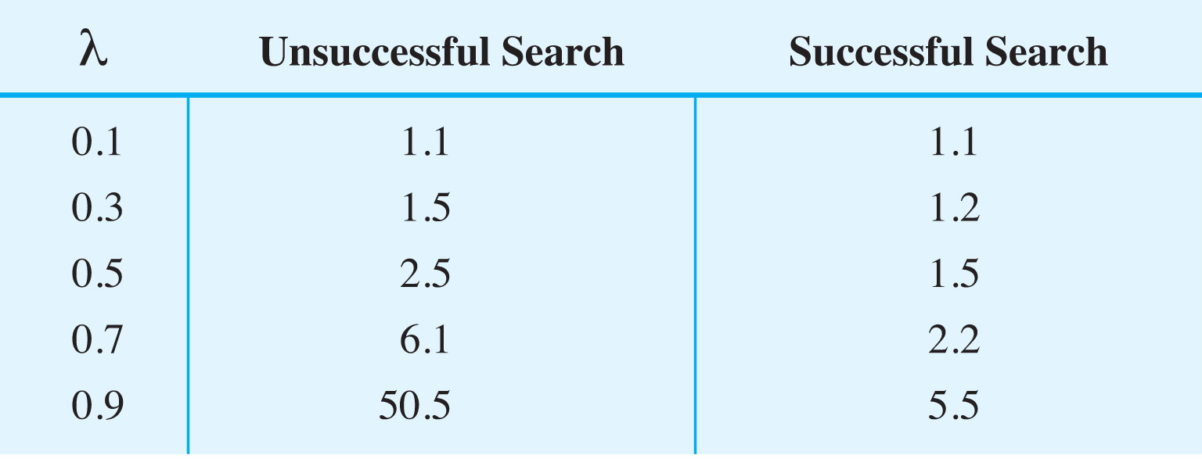
Cost of Open Addressing with Linear Probing
The average number of comparisons required by a search of the hash table for given values of the load factor λ when using linear probing.
Note: to maintain reasonable efficiency, the hash table should be less than half full. That is, keep λ < 0.5

Slide 38
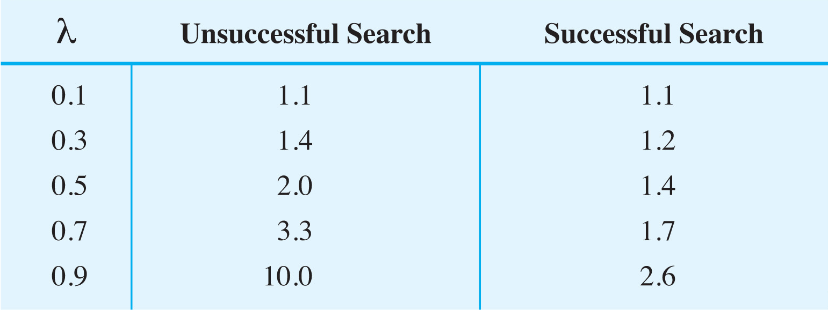
Cost of Open Addressing with Quadratic Probing and Double Hashing
The average number of comparisons required by a search of the hash table for given values of the load factor λ when using either quadratic probing or double hashing.
Note: for quadratic probing or double hashing, should have λ < 0.5

Slide 39
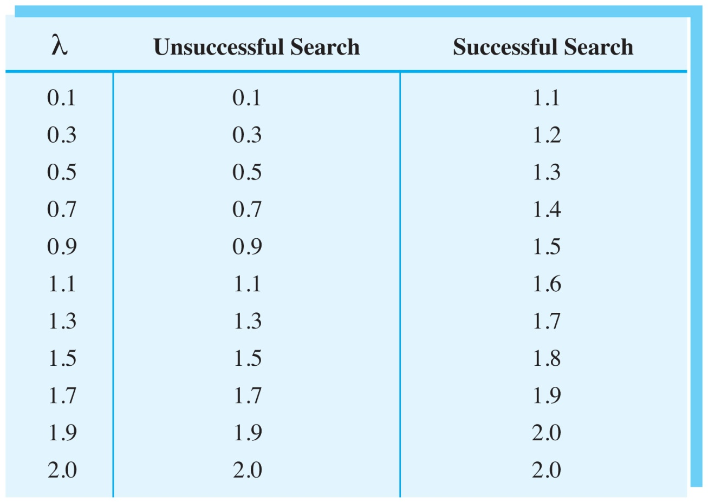
Cost of Separate Chaining
The average number of comparisons required by a search of the hash table for given values of the load factor λ when using separate chaining.
Note: Reasonable efficiency requires only λ < 1

Slide 40
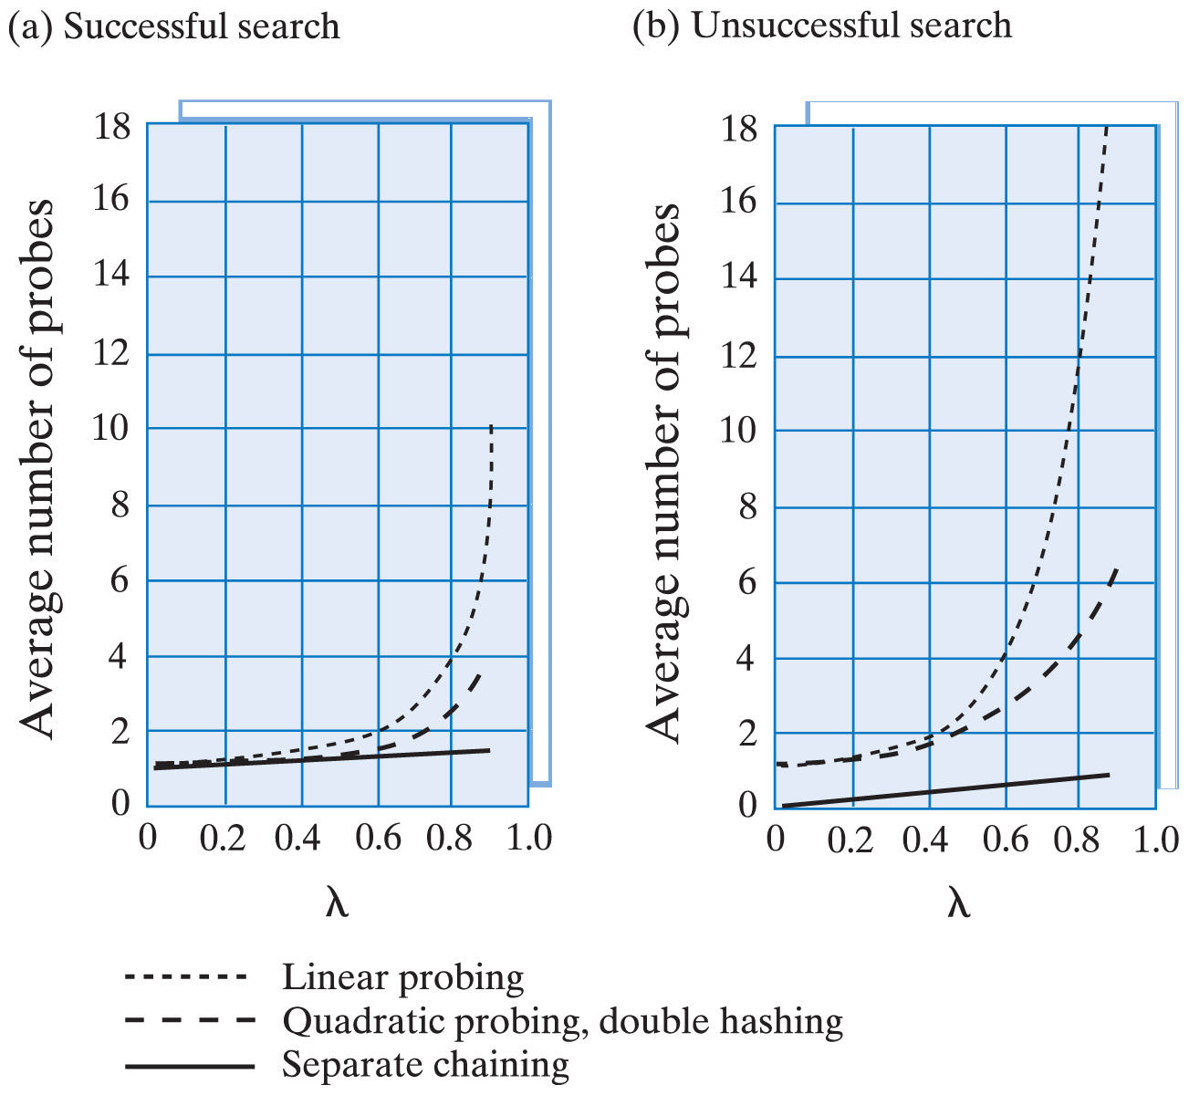
Comparing Schemes for Collision Resolution
The average number of comparisons required by a search of the hash table versus λ for four techniques when search is successful (a) and unsuccessful (b)

Slide 41
Rehashing
When load factor gets too high
  Resize array to a prime number at least twice former size
  Must rehash to different locations c % n, based on new size, n, of array – utilizes method add
Note – this is more work than simply increasing the size of an array
  Not a task to be done often

Slide 42
Question
Consider the following pair of hash functions for a hash table that is filled using Open Addressing with Double Hashing algorithm:
h₁(key) = key modulo tableSize
h₂(key) = key modulo (tableSize - 2)
Function h₁ is used to calculate the initial value of hashIndex for the key, where function h₂ is used to calculate the value of step increase for the index of the same key.
With the initial size of hash table set to 5 and the Load Factor set to .5 add the following seven keys to the hash table: {k1, k2, k3, k4, k5, k6, k7}
Show the content of the hash table when it became full assuming that for all the keys
  h₁(key)returns 2 (hashIndex)
  h₂(key)returns 3 (step increase)
Assuming that with the expanded hash table for all seven keys (k1, k2, k3, k4, k5, k6, k7) hashIndex is now 3, and step increase is now 4
  show the content of the hash table after rehashing.
  show the content of the hash table after the remaining keys are added.

Slide 43
Question
When the method add() calls rehash(), rehash() calls add(). But when rehash() calls add(), does add() call rehash()?

Slide 44
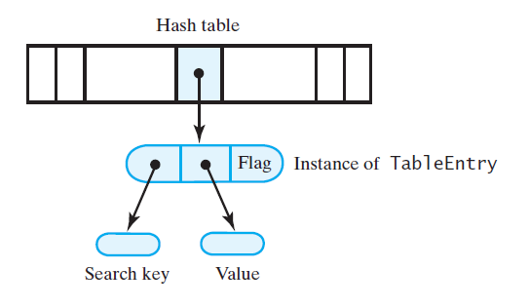
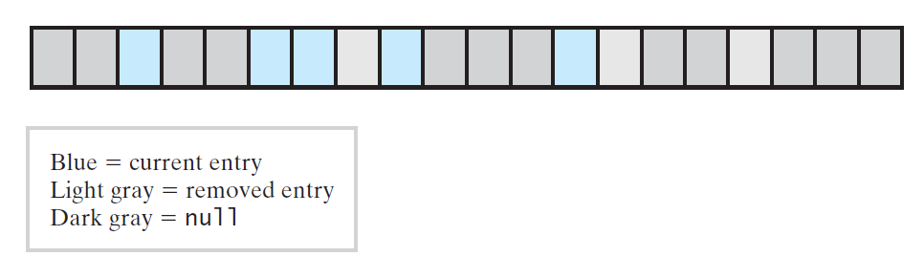
Dictionary Implementation That Uses Hashing
We implement linear probing
  Other open addressing strategies involve few changes
Note source code of class HashedDirectory, Listing 22-1

Slide 45
Java Class Library: The Class HashMap
Standard package java.util contains the class HashMap<K, V>
  assumes that the search-key objects belong to a class that overrides the methods hashCode and equals
  hash table is a collection of buckets, where each bucket can contain several entries
  the constructors enable you to specify the initial number of buckets and the maximum load factor:
    public HashMap()
    public HashMap(int initialSize)
    public HashMap(int initialSize, float maxLoadFactor)
    public HashMap(Map<? extends K,? extends V> table)

Slide 46
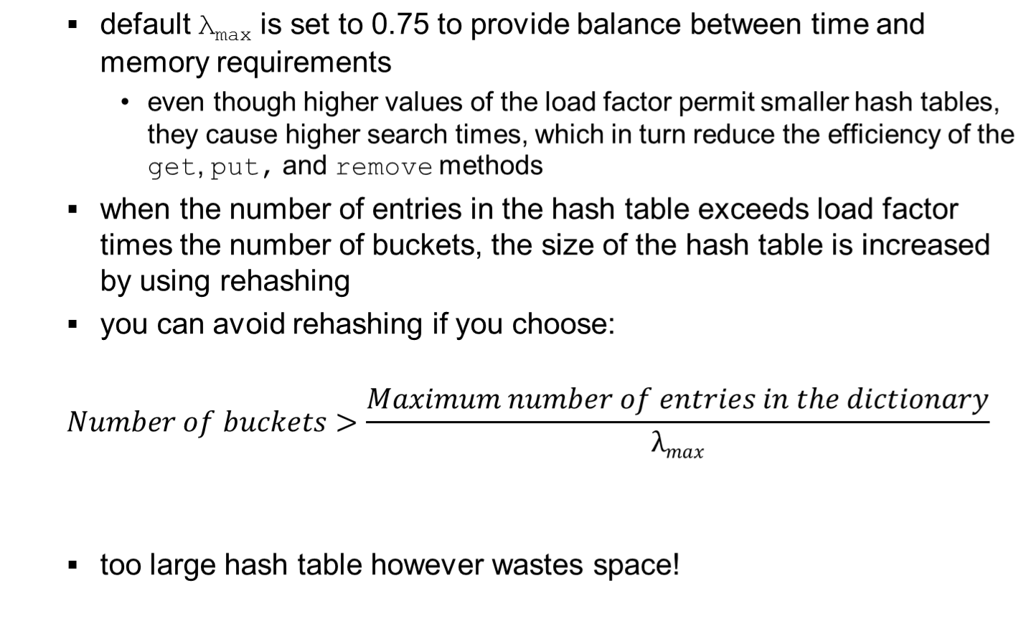
Java Class Library: The Class HashMap

Slide 47
Java Class Library: The Class HashSet
Implements the interface java.util.Set
  set is a collection that does not allow duplicates but otherwise is similar to a bag
  uses an instance of the class HashMap to contain entries in a set
Constructors
  public HashSet()
  public HashSet(int initialCapacity)
  public HashSet(int initialCapacity,
  float loadFactor)

Slide 48
BTW
  Have you checked the Java Collection Framework (JCF)?
  Have you looked at the JCF Tutorial?
  It’s a good idea to have a look. The more JCF you know the better Java developer you will be…
  In general, the following is the link that you want to know:
      http://docs.oracle.com/javase/8/docs/

Slide 49
Introducing Google Translate for Animals

